Slide 1






Rain in Australia
Project
Presented by: Fidan Karimli

Slide 2

Overview
Business case
Data Understanding
EDA
Data Cleaning and Preprocessing
Modelling and Feature Engineering
Evaluation

Slide 3



Introduction
Predict next-day rain by training classification models on the target variable RainTomorrow.
This dataset contains about 10 years of daily weather observations from many locations across Australia.
RainTomorrow is the target variable to predict. It means -- did it rain the next day, Yes or No? This column is Yes if the rain for that day was 1mm or more.

Slide 4
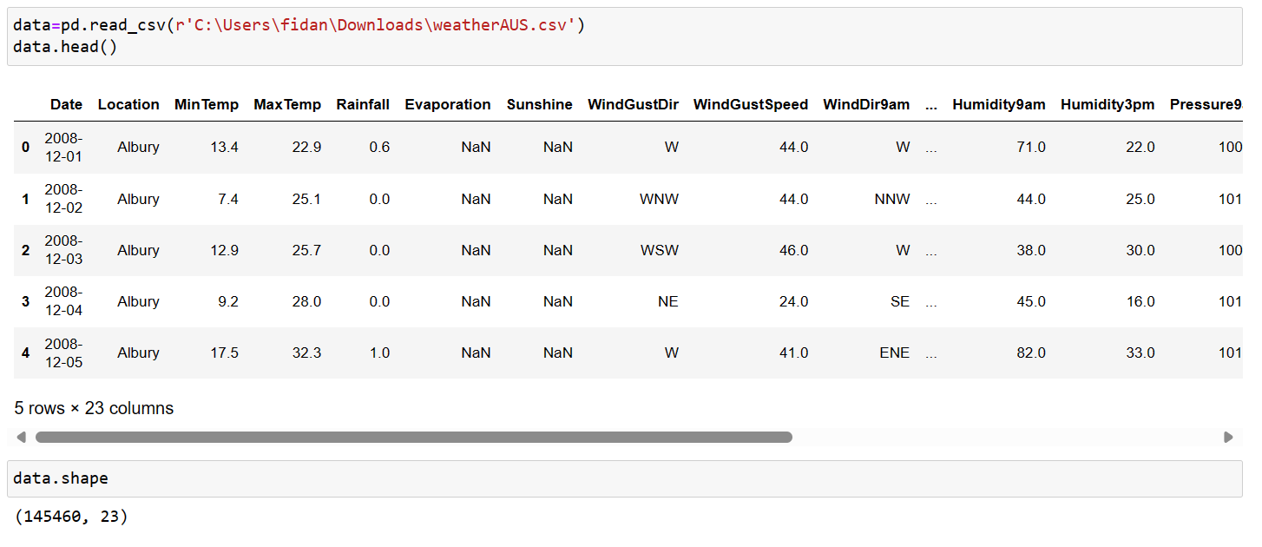
DATA

Slide 5




DATA ANALYSIS(EDA)

Slide 6
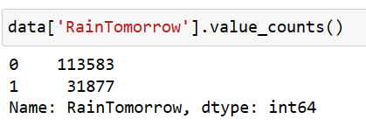
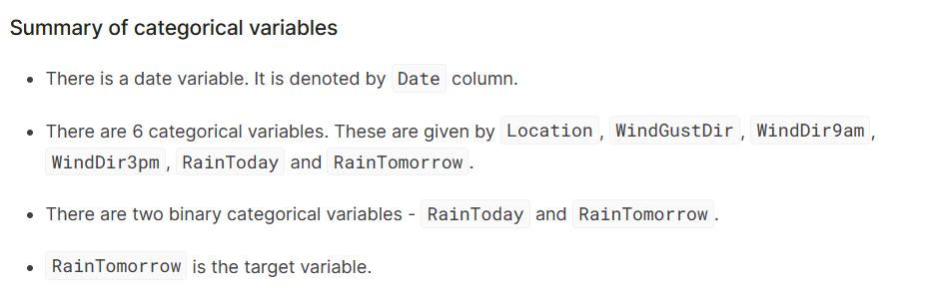

Slide 7
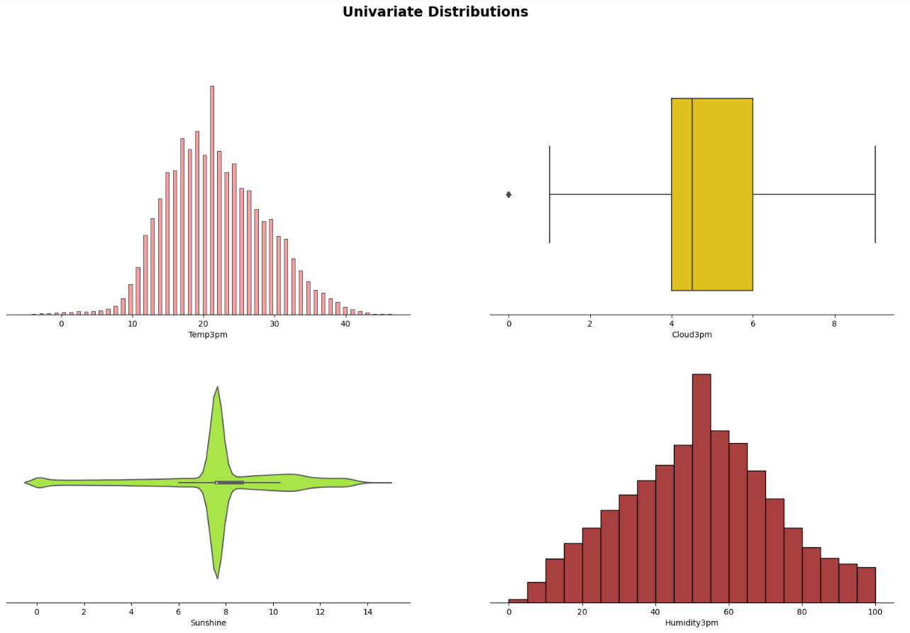

Slide 8
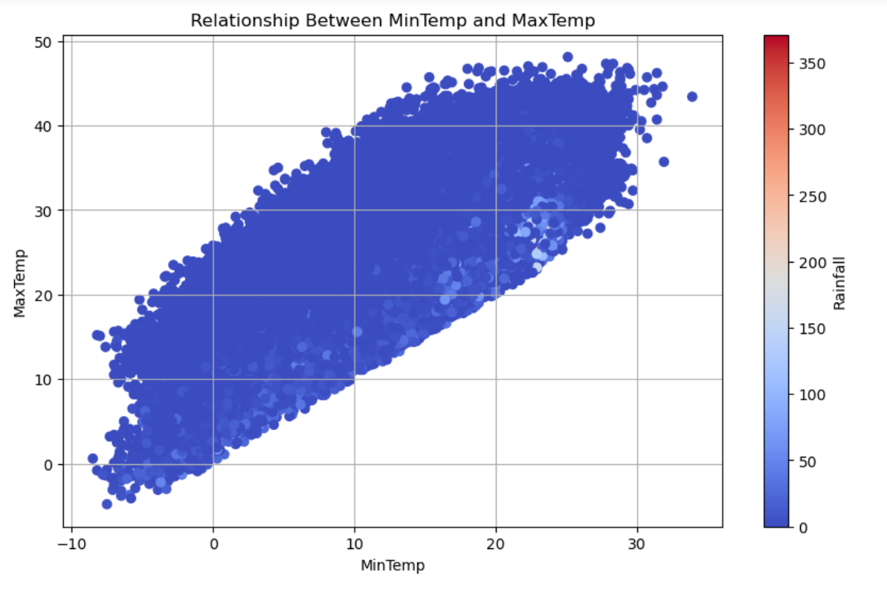

Slide 9
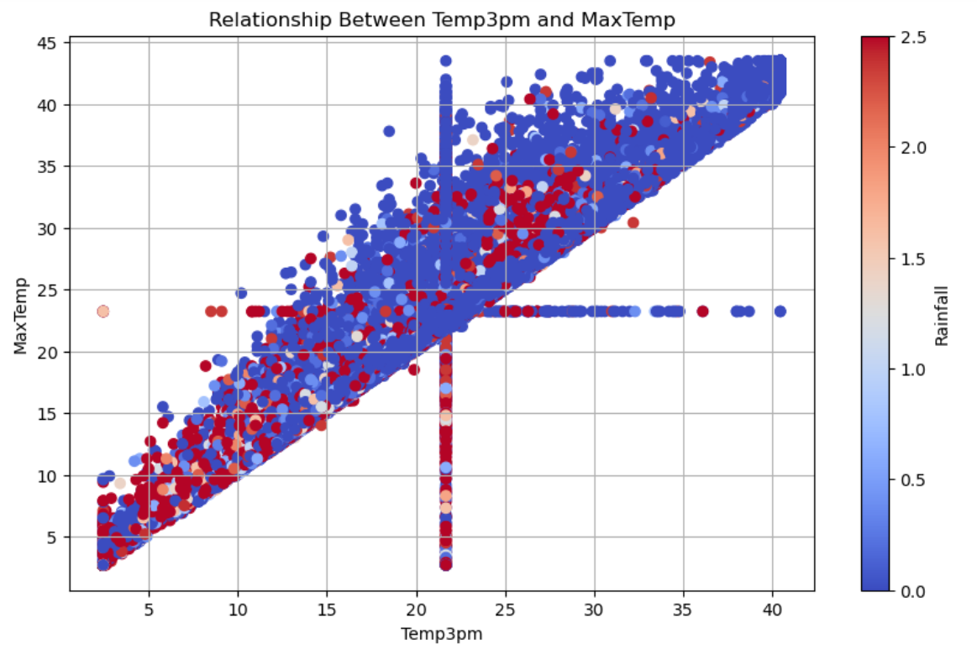

Slide 10
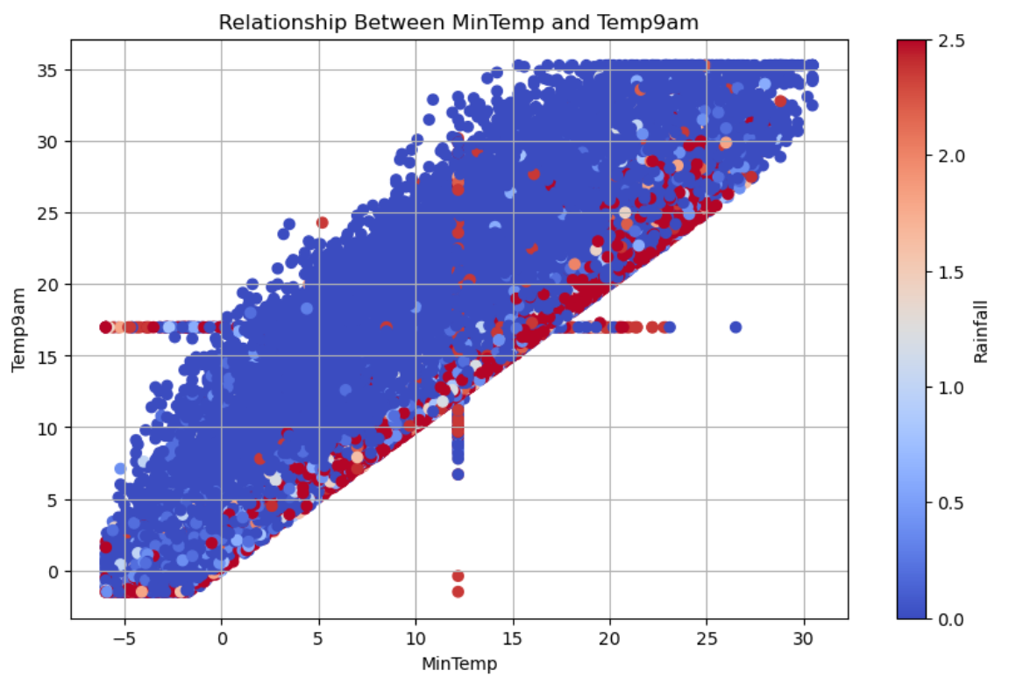

Slide 11
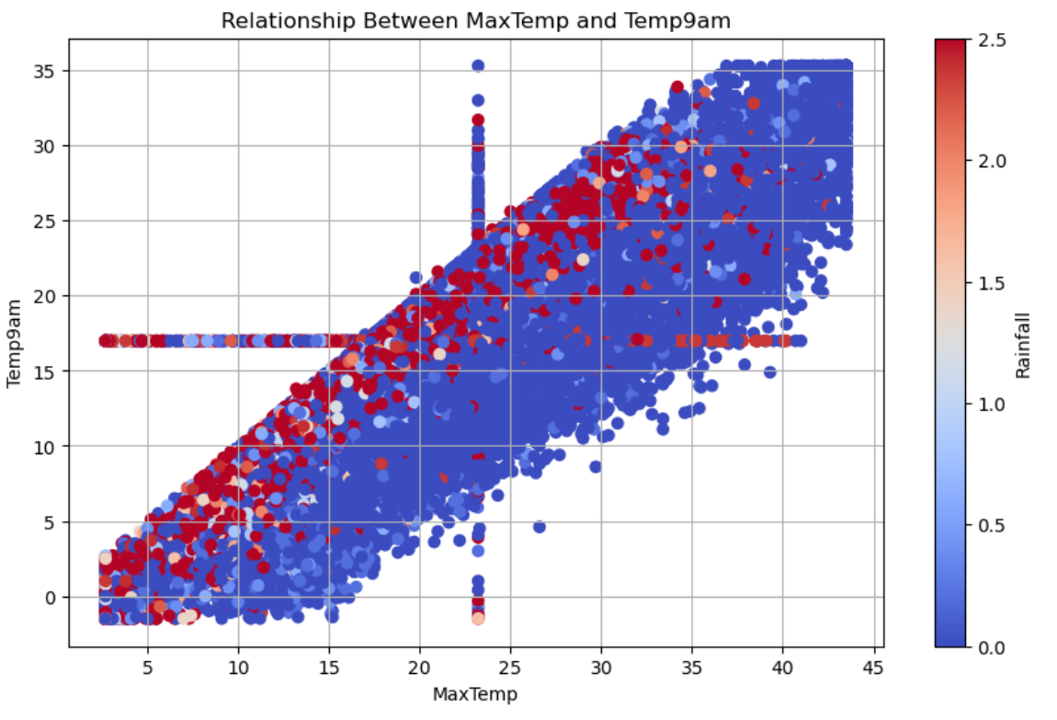

Slide 12
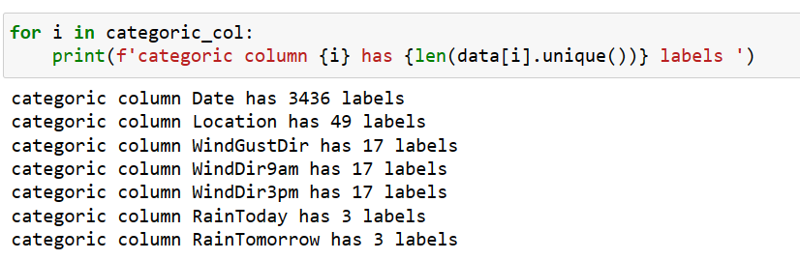

Preprocessing
We can see that there is a Date variable which needs to be preprocessed. I will do preprocessing in the following section.All the other variables contain relatively smaller number of variables.

Slide 13
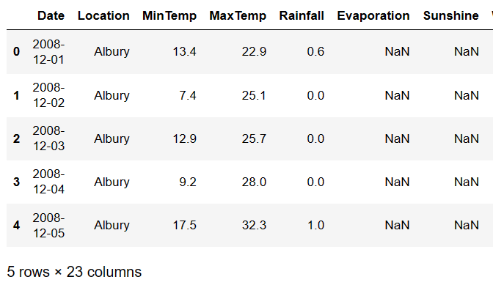
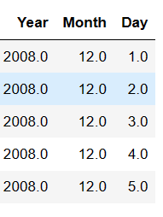

Slide 14
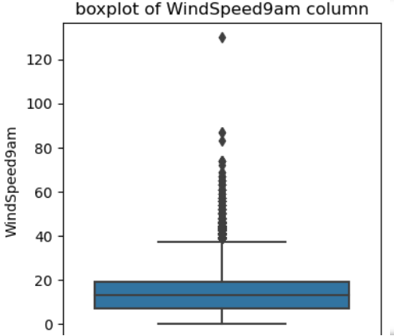
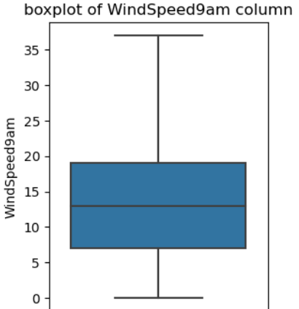
BEFORE OUTLIER TREATMENT
AFTER OUTLIER TREATMENT

Slide 15
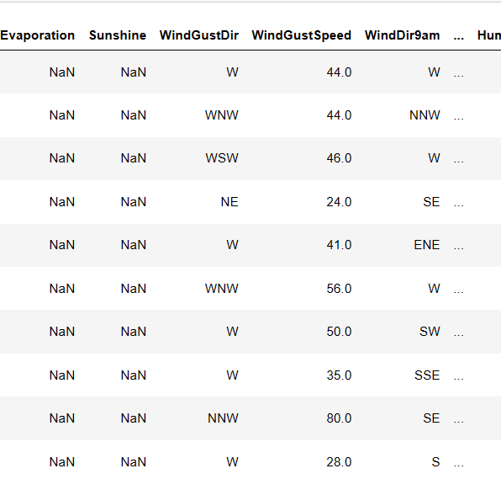
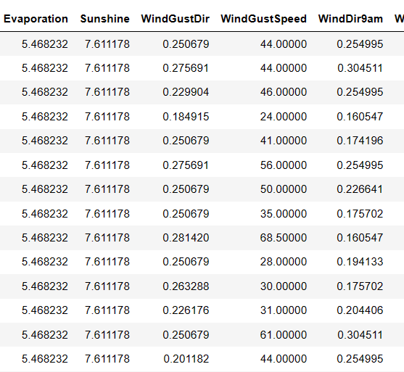
BEFORE
AFTER

Slide 16
MODELLING(LOGISTIC REGRESSION)

Slide 17
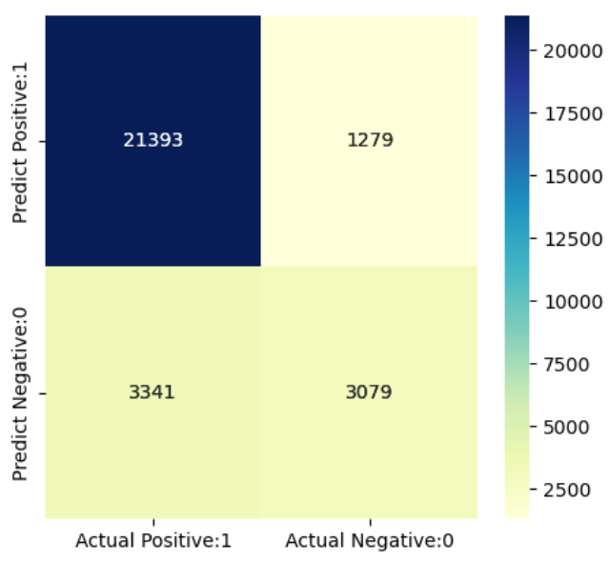
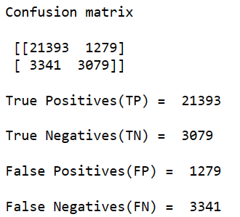


Slide 18
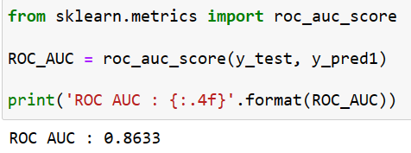
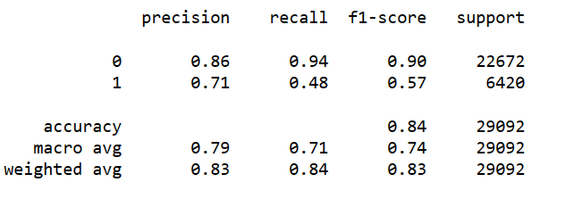
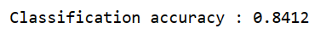
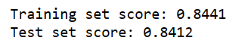
METRICS

Slide 19
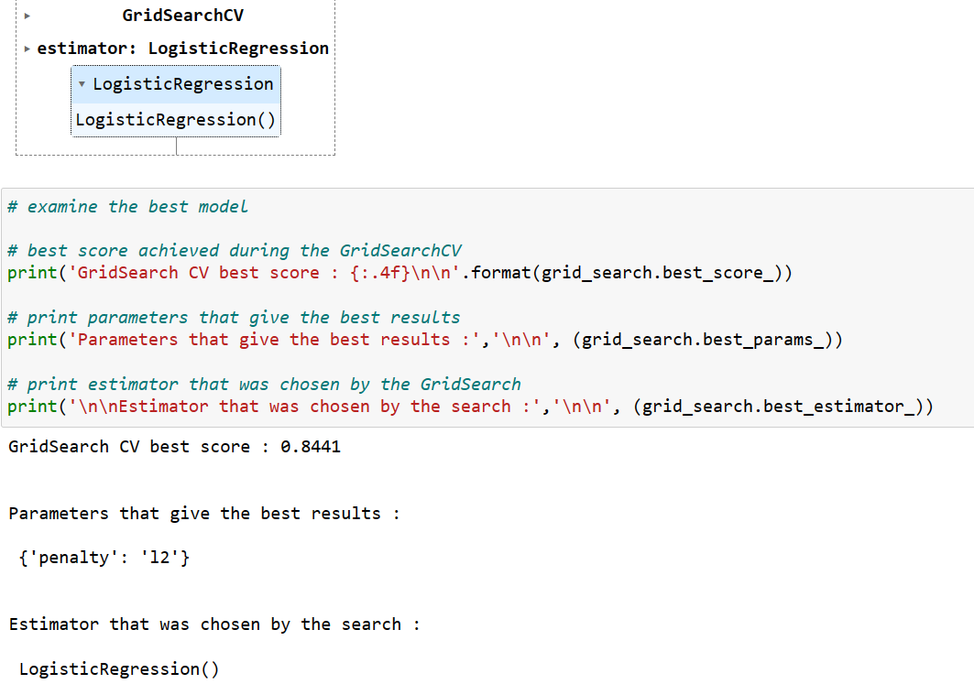

Slide 20
Before GridSearch CV
After GridSearch CV

Slide 21

Thanks For Watching

